Slide 1
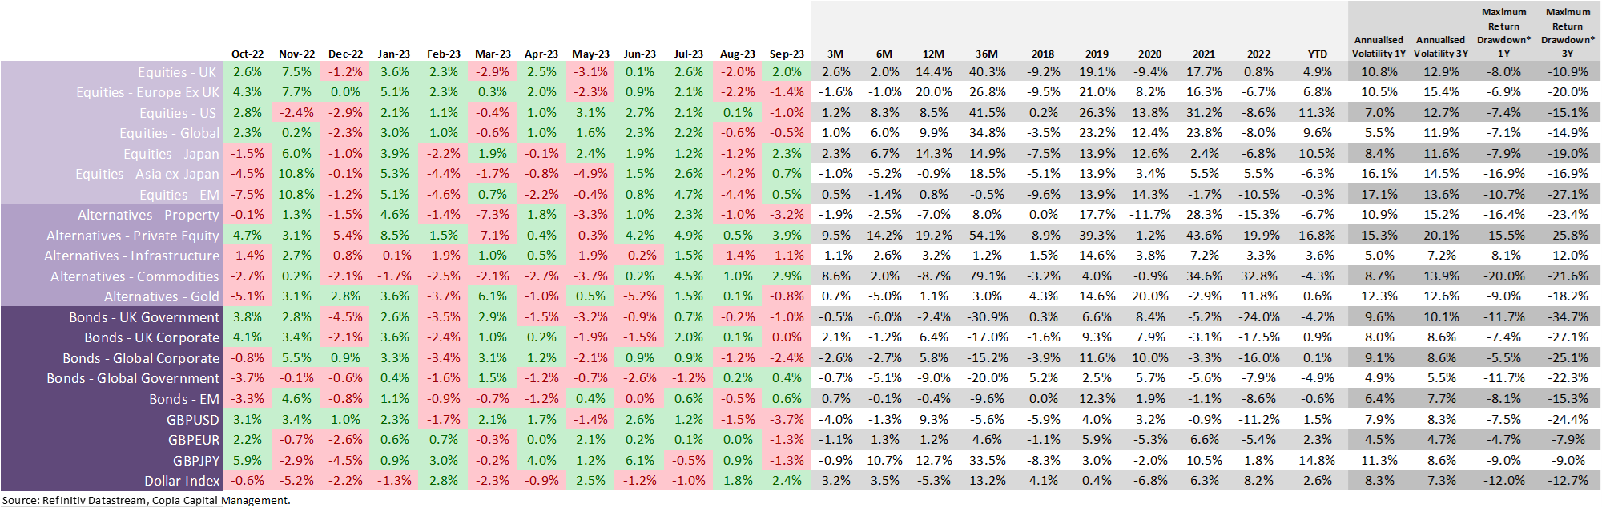


Monthly performance overview: as of 30 September 2023
Asset class overview: performance table
Notes:
Returns based on Total return, assuming income is re-invested immediately and rebalanced on due dates.
The performance of each asset class is represented by relevant indices and expressed in GBP terms, which are selected by Copia Capital Management. Reference to a particular asset class does not represent a recommendation to seek exposure to that asset class. *Maximum Return Drawdown is defined as the largest single drop from peak to trough of the value of an asset class or portfolio over any timeframe within the stated period. This information is included for comparison purposes for the period stated but is not an indicator of potential maximum loss for other periods or in the future.

Slide 2
Portfolio Performance
Select Volatility
Previously known as ‘Volatility Focus’
Select Thematic
Previously known as ‘Copia Enhanced Equity’
Notes: Returns based on Total return, assuming income is re-invested immediately and rebalanced on due dates.

Slide 3
Portfolio Performance
Select Accumulation
Previously known as ‘Select’
Select ESG
Notes: Returns based on Total return, assuming income is re-invested immediately and rebalanced on due dates.

Slide 4
Portfolio Performance
Select Accumulation USD
Previously known as ‘Select USD’
Select Accumulation EUR
Previously known as ‘Select EUR’
Notes: Returns based on Total return, assuming income is re-invested immediately and rebalanced on due dates.
Copia Select USD and EUR models are available only on the Novia Global platform.

Slide 5
Portfolio Performance
Select Decumulation
Previously known as ‘Retirement Income’
Notes: Returns based on Total return, assuming income is re-invested immediately and rebalanced on due dates.

Slide 6
Portfolio Performance
Select Retirement Income
Select Retirement Income Plus
Notes: Returns based on Total return, assuming income is re-invested immediately and rebalanced on due dates.

Slide 7
Portfolio Performance
Select Preservation
Select Short Duration Bond Portfolio
Notes: Returns based on Total return, assuming income is re-invested immediately and rebalanced on due dates.

Slide 8
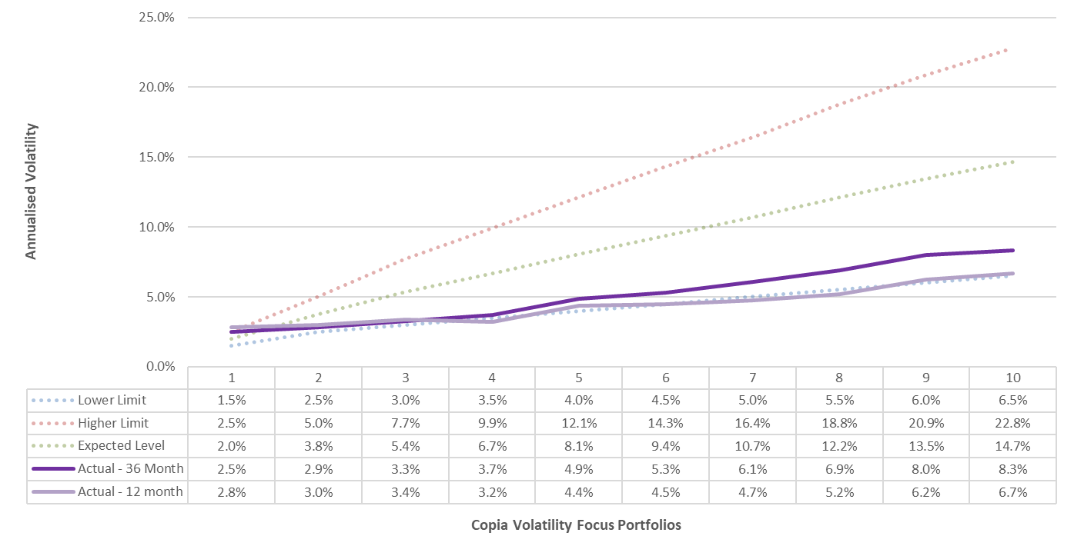
Select Volatility : outcome chart
Outcome analysis as of 30 September 2023
Our ‘Select Volatility’ portfolio was previously known as ‘Volatility Focus’.
For illustration only.
Returns based on Total return, assuming income is re-invested immediately and rebalanced on due dates.

Slide 9
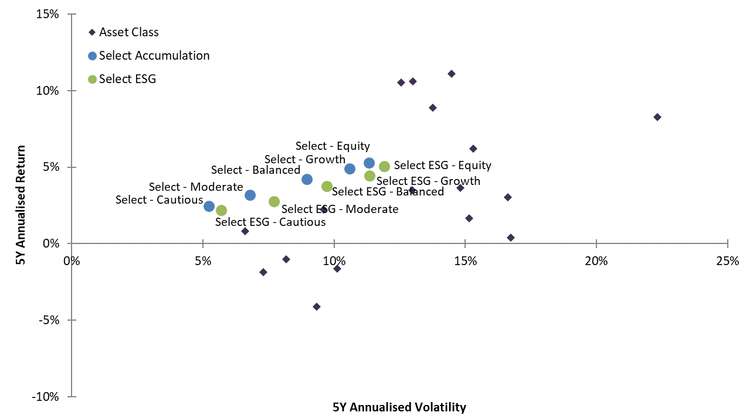
Select Accumulation and Select ESG: outcome chart
Outcome (risk-return) analysis as of 30 September 2023
Our ‘Select Accumulation’ portfolio was previously known as ‘Select’.
For illustration only.
Returns based on Total return, assuming income is re-invested immediately and rebalanced on due dates.
The annualised risk and return figures are calculated based on a historic 5-year period as of 30-Sep-2023.
The performance figures for Select ESG portfolios include simulated data before the inception date of the Select ESG portfolios (31-Mar-2020).

Slide 10
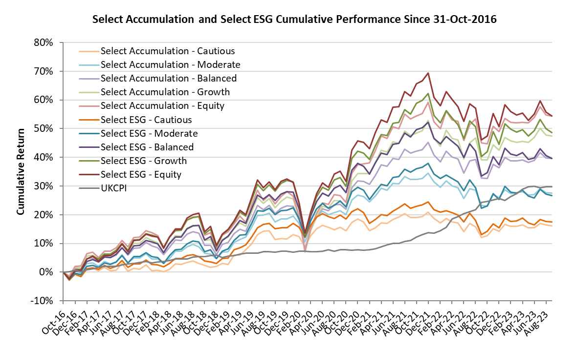
Select Accumulation and Select ESG: outcome chart
Outcome (cumulative return) analysis as of 30 September 2023
Our ‘Select Accumulation’ portfolio was previously known as ‘Select’.
For illustration only.
Returns based on Total return, assuming income is re-invested immediately and rebalanced on due dates.
Available CPI data has been used as a comparator for real returns. CPI data for Sep 2023 is currently unavailable and not shown.
The cumulative returns are calculated based on the period from the inception date of the Select Accumulation portfolios (31-Oct-2016). The performance figures for Select ESG portfolios include simulated data before the inception date of the Select ESG portfolios (31-Mar-2020).

Slide 11
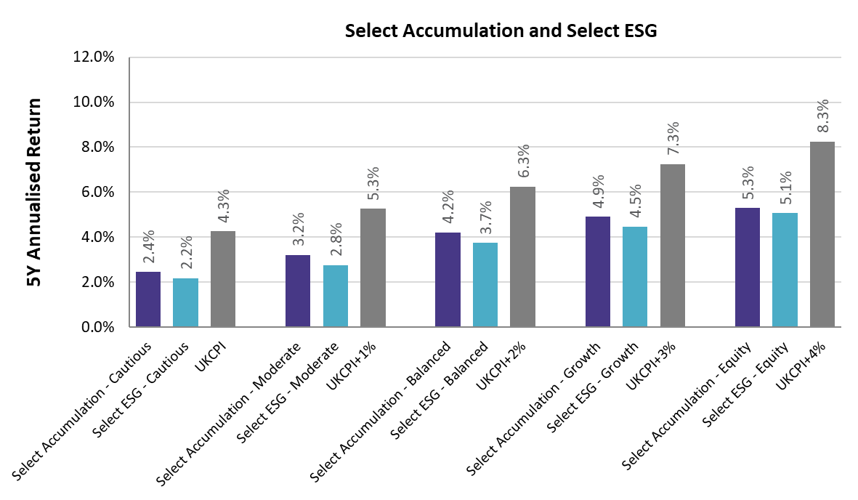
Select Accumulation and Select ESG: outcome chart
Outcome (annualised return) analysis as of 30 September 2023
Our ‘Select Accumulation’ portfolio was previously known as ‘Select’.
For illustration only.
Returns based on Total return, assuming income is re-invested immediately and rebalanced on due dates.
Available CPI data has been used as a comparator for real returns. CPI data for Sep 2023 is currently unavailable and not shown.
The annualised returns are calculated based on a historic 5-year period as of 30-Sep-2023.
The performance figures for Select ESG portfolios include simulated data before the inception date of the Select ESG portfolios (31-Mar-2020).

Slide 12
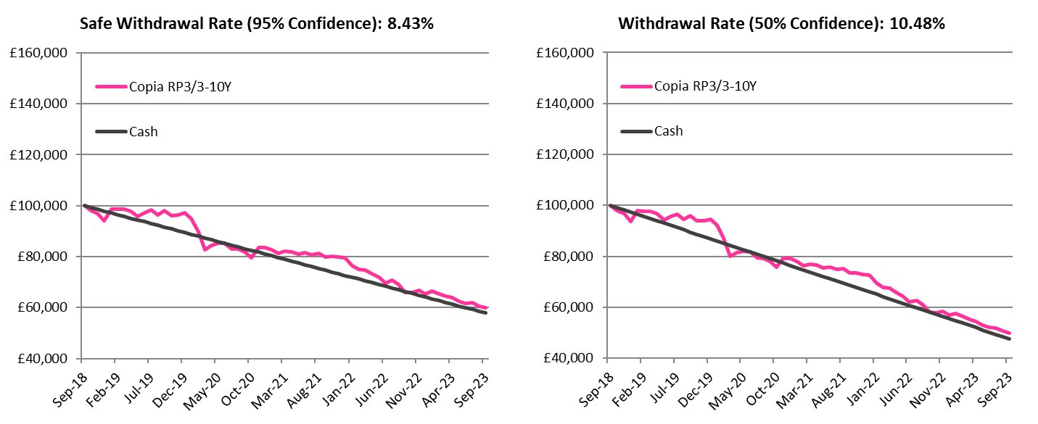
Select Decumulation: outcome chart
Outcome analysis as of 30 September 2023
Our ‘Select Decumulation’ portfolio was previously known as ‘Retirement Income’.
For illustration only.
Returns based on Total return, assuming income is re-invested immediately and rebalanced on due dates.
The returns are calculated based on a historic 5-year period as of 30-Sep-2023.

Slide 13
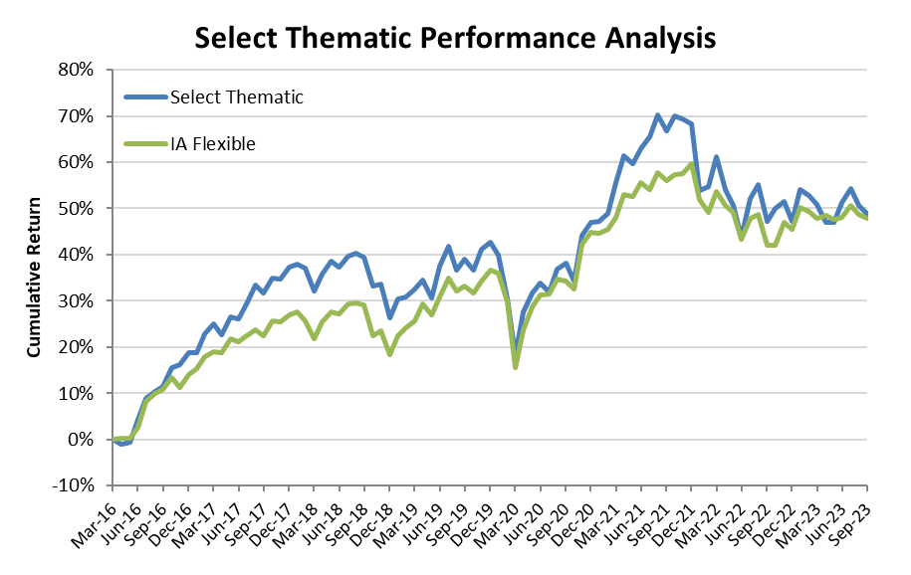
Select Thematic : outcome chart
Outcome analysis as of 30 September 2023
Our ‘Select Thematic’ portfolio was previously known as ‘Copia Enhanced Equity’.
For illustration only.
Returns based on Total return, assuming income is re-invested immediately and rebalanced on due dates.

