Slide 1


Quarterly Performance Update
30 June 2021
Copia Capital Management
The art of portfolio construction
For professional investors only

Slide 2
Market performance
Macro update
Risk barometer
Portfolio performance
Outcome charts

Slide 3
Market performance
Market performance Q2 2021
Although Q2 2021 ended in good gains for equity markets, the journey up was a volatile one. On the positive side, developed economies continued to open up and a high proportion of the population in US, UK and EU have been vaccinated, giving the market increased optimism the growth trend is set to continue. GDP QoQ annualised in the US are averaging around 5% which is something the markets haven’t seen in over a decade. All regional equity markets were up in the 2nd quarter of 2021 except for Japan as it saw a large uptick in covid cases leading to fresh lockdowns being announced.
Volatility in the markets was caused by the US Fed when it turned slightly hawkish in their stance by mentioning that they are thinking about tapering the bond buying programme. This jolted stock markets but the Fed immediately reassured the market saying rate hikes are planned from 2023 and onwards. Placating fears that the Fed will cause the economic expansion to abruptly end.
Bond markets were slightly positive for the quarter as yields pulled back a little, while currency markets remained unchanged. Gold had a volatile 3 months but has pulled back what it lost in the May sell-off.
Source: Refinitiv Datastream, Copia Capital Management
All numbers expressed in GBP

Slide 4
Market performance
Macro update
Risk barometer
Portfolio performance
Outcome charts

Slide 5
Macro update: growth
Record UK GDP growth expected in Q2
UK GDP is expected to experience a significant bounce back in Q2 2021. Data is to be released on 12 August 2021 and estimates range around 20%+, which would make it one of highest it has ever been in the last century. A strong rebound has been possible as the country has opened up and vaccination rates are one of the best in the world.
The UK Composite PMI in June 2021 rose to a 7 year high of 62.2 up 57 in March. Both Services and Manufacturing sectors had a rapid expansion near the ending of lockdown. Markets expect the robust growth to continue in Q3 with the reopening of the economy and a high level of consumer confidence.
Source: Refinitiv Datastream, Copia Capital Management

Slide 6
Macro update: inflation
Rising inflation expectations with an improving labour market
UK Inflation jumped to 2.5% YoY in June 2021 and Bank of England expects CPI to hit 3% YoY later this year. Most of the inflation in expected to be transitory as prices are coming off the very low base from last year. The expected rate of inflation implied from the 5yr breakeven rate rose from 3.5% to 3.7% over the quarter, which is at its highest level since 2008. This means that investors are now concerned that the prices may rise too fast in the next 5 years with the accommodative policy measures by government and BoE.
UK unemployment rate continued to drop and is currently at 4.7% for the months of January to April. The number of unemployed people is down by 90,000 to 1.61 million, with a very hot hiring market indicating the recovery is on track.
Source: Refinitiv Datastream, Copia Capital Management

Slide 7
Macro update: rates
UK yield curve remains steep
With comments from the central bank and inflation holding steady at high rates, longer term bonds rallied and yields dropped slightly, but the yield curve in the UK and US continues to remain normal shaped. Economists view a positive sloped yield curve as a good sign indicating the economy is healthy and growing.
In Q2, the Fed signalled they are due to review its bond buying programme which is currently running at $120 Billion a month. Inflation projections are currently at 3.5% for the year exceeding Fed’s target of 2% but concerns linger that inflation could remain above target over the next 2 years.
Source: Refinitiv Datastream, Copia Capital Management

Slide 8
Macro update: Fed
Fed maintaining rates at historic lows but adopts a hawkish tone
The US Fed kept the federal funds rate target range unchanged at 0.00-0.25% but have brought forward the planned rate hikes from 2024 to 2023 as they have witnessed clear signs of economic progress being achieved. Maximum employment and pricing stability are still the main goals and the central bank agreed that an inflation overshoot could be a risk in short-term while it has to remain accommodative to fulfil the "dual mandate“ over long-term.
Although, the monthly bond purchases were maintained at $120bn, the Fed has alluded they would look to taper the bond buying programme at some point this year. This could potentially add pressure on longer maturity bonds.
Source: Refinitiv Datastream, Copia Capital Management

Slide 9
Market performance
Macro update
Risk barometer
Portfolio performance
Outcome charts

Slide 10
Copia Risk Barometer
Copia Risk Barometer
+0.71
As of 31-March-2021
+0.65
As of 30-June-2021
Based on our proprietary Prediction Algorithm the Copia Risk Barometer is now reading +0.65 as of 30-June-2021, a change of -0.06 from last quarter, staying in the Green zone, indicating that the global economic outlook is positive.
Primary drivers for the Risk Barometer:
Government bond markets: Government bond yield curves around the world have normalized with short term yields remain much
Lower than long term yields. Bond markets are signalling strong economic growth on the horizon with higher inflation expectations. A positive signal for risk assets.
Equity market pricing: Economic data continues to be positive along with price momentum in equity markets. Equity markets are
indicating co-ordinated global growth. The equity market pricing remains a positive for risk assets.
Credit Spreads: Credit spreads continue to remain tight similar to pre-pandemic levels indicating corporate bond investors are fully
convinced central banks will do whatever it takes to prevent companies from defaulting on debt. A positive signal for risk assets.
Overall: Positive signals are being picked up by the Risk Barometer as the Global economic outlook has improved and is positive
going forward.
Note: The Risk Barometer score varies between -1.0 and +1.0. A score of -1.0 indicates an extremely poor economic outlook, which is accompanied by a high probability of negative returns in risky asset classes. A score of 0 indicates a neutral economic outlook with almost equal probability of positive and negative returns in risky asset classes. A score of +1.0 indicates an extremely positive economic outlook, which is accompanied by a high probability of positive returns in risky asset classes.
10

Slide 11
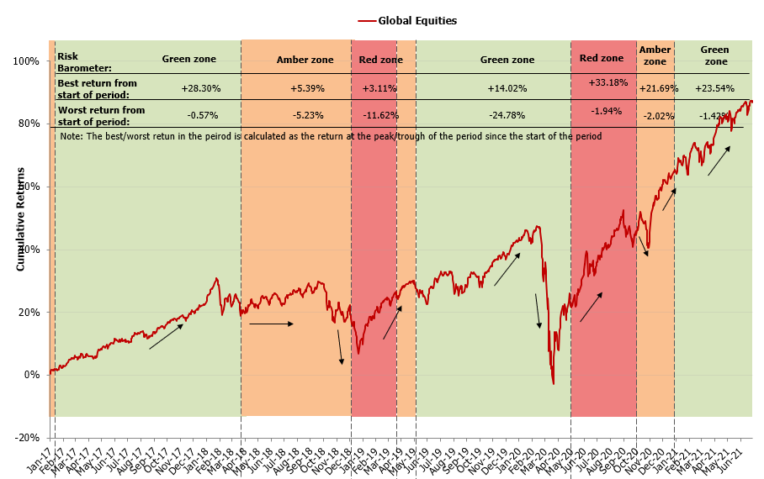
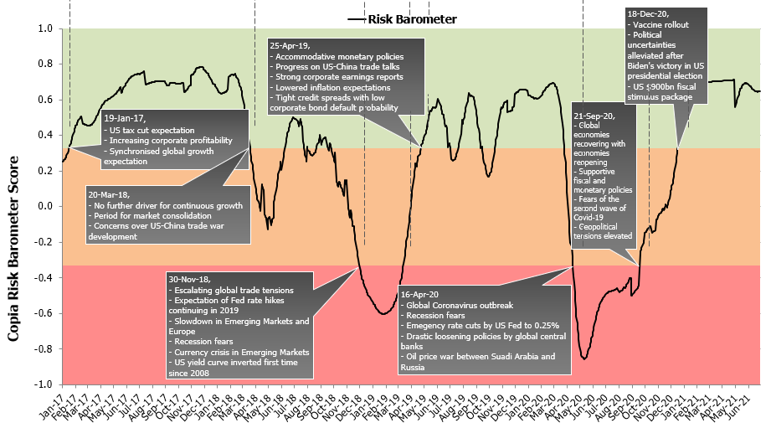



Copia Risk Barometer
Risk Barometer history
The top chart shows the market performance (best and worst returns) during different Risk Barometer regimes.
The bottom chart shows how the Risk Barometer has moved between different regimes and the triggers for regime changes.
The Risk Barometer is a forward-looking quantitative model that provides a systematic rules-based approach for dynamic risk management.
Note: The Risk Barometer score varies between -1.0 and +1.0.
A score of -1.0 indicates an extremely poor economic outlook, which is accompanied by a high probability of negative returns in risky asset classes.
A score of 0 indicates a neutral economic outlook with almost equal probability of positive and negative returns in risky asset classes.
A score of +1.0 indicates an extremely positive economic outlook, which is accompanied by a high probability of positive returns in risky asset classes.
Source: Copia research, Refinitiv Datastream
Global Equities Returns is based on actual data of MSCI World Index for the period between 31-Dec-2016 and 30-June-2021.
11
Notes:
The Risk barometer is an output of the Copia quant model.
A score of -1.0 indicates an extremely poor economic outlook, which is accompanied by a high probability of negative returns in risky asset classes like equities. These periods are typically recessionary periods in the business cycle. The Risk Barometer tilts our portfolios away from equities during such periods.
A score of 0 indicates a neutral economic outlook with almost equal probability of positive and negative returns in risky asset classes like equities. The Risk Barometer maintains a balance between equities and other asset classes during such periods.
A score of 1.0 indicates an extremely positive economic outlook, which is accompanied by a high probability of positive returns in risky asset classes like equities. These periods are typically expansionary periods in the business cycle. The Risk Barometer tilts our portfolios towards equities during such periods.

Slide 12
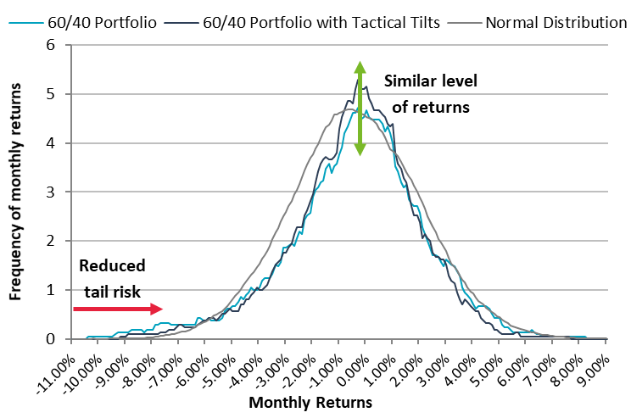
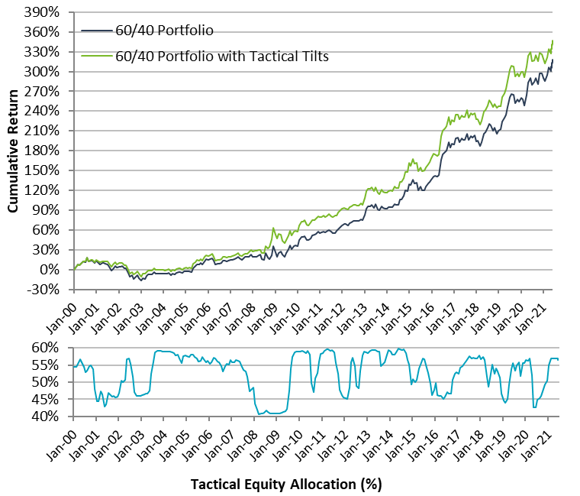
Risk Barometer Simulated Impact
Impact of dynamic risk management using the Risk Barometer
Objective is to achieve similar levels of returns, with a narrower dispersion of returns (reduced tail risk)
Can enhanced risk-adjusted returns
Can deliver a smoother investment journey whilst mitigating downside risk
We evaluate impact using a theoretical 60/40 portfolio with and without the Risk Barometer
 | Annualised Return | Annualised Volatility | Sharpe Ratio | Maximum Drawdown
60/40 Portfolio | 6.37% | 9.28% | 0.69 | -29.28%
60/40 Portfolio with Tactical Tilts | 6.67% | 8.92% | 0.75 | -24.03%
Impact | 0.30% | -3.93% | 8.99% | -17.92%
Note: 60/40 Portfolio consists of 60% allocation to MSCI World Index and 40% allocation US 10 year Bond Index rebalanced monthly. Figures are based on historic actual figures in GBP terms for the period 31-Jan-2000 and 30-June-2021. All return figures are before fees.
The 60/40 Portfolio with Tactical Tilts consists of dynamic allocation to MSCI World Index within a range of 40% to 60% driven by the Risk Barometer. The portfolio is rebalanced monthly and remaining allocation is to US 10 year Bond Index.
Source: Copia research, Refinitiv Datastream
Source: Copia Capital Management

Slide 13
Market performance
Macro update
ETF Flows
Risk barometer
Portfolio performance
Outcome charts

Slide 14
Select and Select ESG performance table
As of 30 June 2021

Slide 15
Retirement Income performance table
As of 30 June 2021

Slide 16
Volatility Focus performance table
As of 30 June 2021

Slide 17
Enhanced Equity performance table
As of 30 June 2021

Slide 18
Market performance
Macro update
ETF Flows
Risk barometer
Portfolio performance
Outcome charts

Slide 19
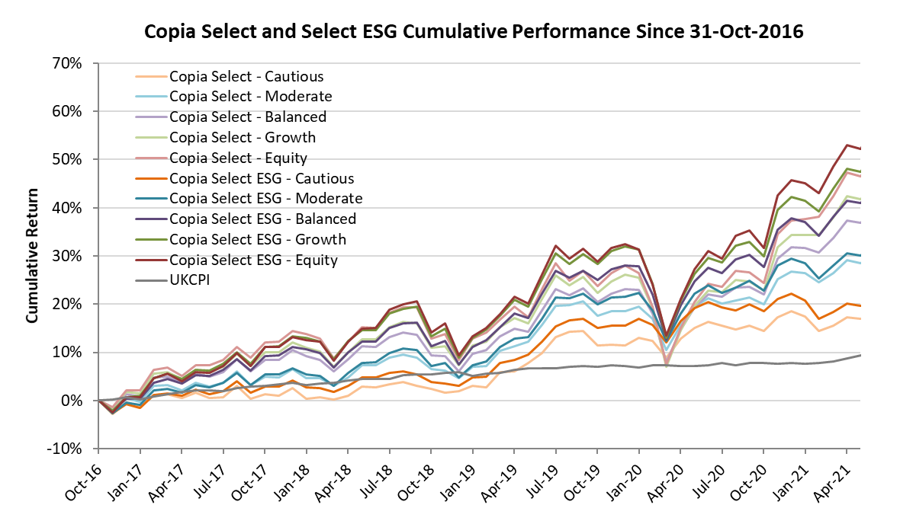
Select and Select ESG: outcome chart
Outcome (cumulative return) analysis as of 30 June 2021
For illustration only.
Returns based on Total return, assuming income is re-invested immediately and rebalanced on due dates.
Available CPI data has been used as a comparator for real returns. CPI data for May 2021 is currently unavailable and not shown.
The cumulative returns are calculated based on the period from the inception date of the Select portfolios (31-Oct-2016). The performance figures for Select ESG portfolios include simulated data before the inception date of the Select ESG portfolios (31-Mar-2020)
19

Slide 20
Select and Select ESG: outcome chart
Outcome (risk-return) analysis as of 30 June 2021
For illustration only.
Returns based on Total return, assuming income is re-invested immediately and rebalanced on due dates.
The annualised risk and return figures are calculated based on the period from the inception date of the Select portfolios (31-Oct-2016) to 30-June-2021. The performance figures for Select ESG portfolios include simulated data before the inception date of the Select ESG portfolios (31-Mar-2020)
20

Slide 21
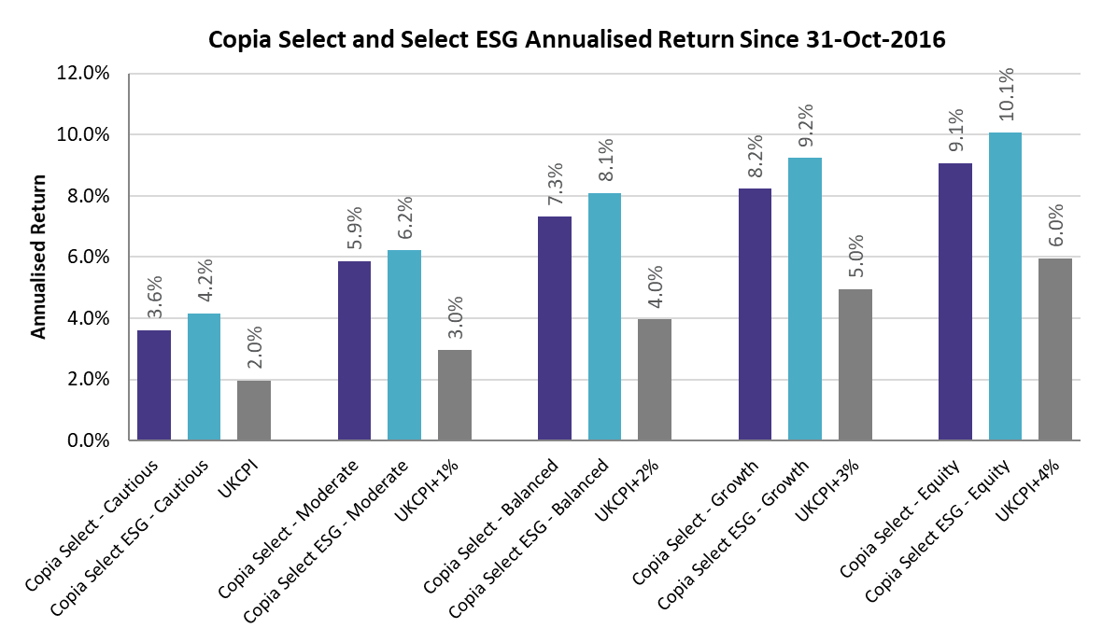
Select and Select ESG: outcome chart
Outcome (annualised return) analysis as of 30 June 2021
For illustration only.
Returns based on Total return, assuming income is re-invested immediately and rebalanced on due dates.
Available CPI data has been used as a comparator for real returns. CPI data for May 2021 is currently unavailable and not shown.
The annualised returns are calculated based on the period from the inception date of the Select portfolios (31-Oct-2016). The performance figures for Select ESG portfolios include simulated data before the inception date of the Select ESG portfolios (31-Mar-2020)
21

Slide 22
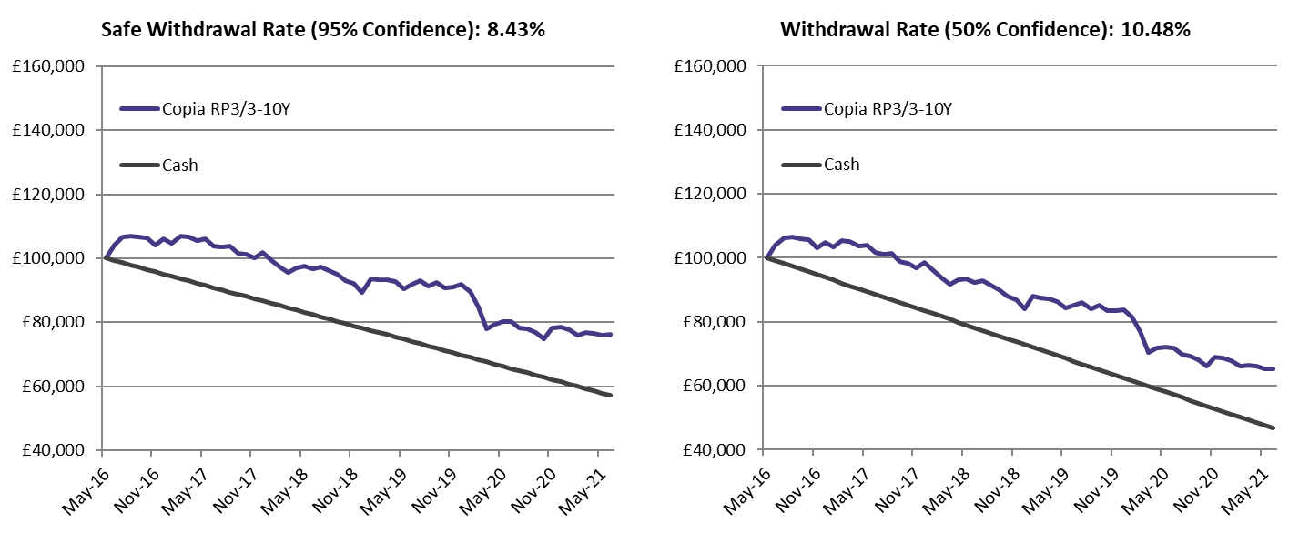
Retirement Income: outcome chart
Outcome analysis as of 30 June 2021
For illustration only.
Returns based on Total return, assuming income is re-invested immediately and rebalanced on due dates.
Performance includes simulated performance for data prior to launch date (28-Feb-2017). Actual data is used from 1-Mar-2017 to Present
22

Slide 23
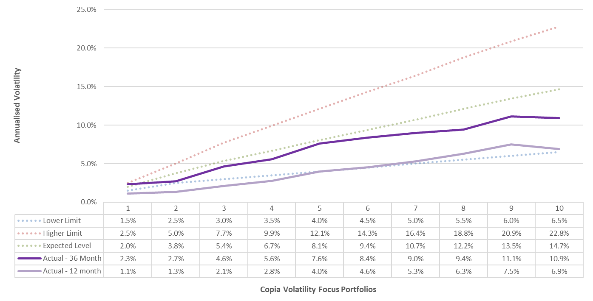
Volatility Focus: outcome chart
Outcome analysis as of 30 June 2021
For illustration only
Returns based on Total return, assuming income is re-invested immediately and rebalanced on due dates.
23

Slide 24
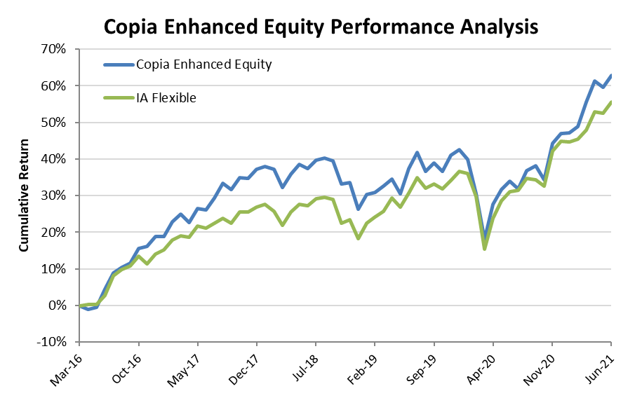
Enhanced Equity portfolio: outcome chart
Outcome analysis as of 30 June 2021
For illustration only.
Returns based on Total return, assuming income is re-invested immediately and rebalanced on due dates.
24

Slide 25

Copia Capital Management
The art of portfolio construction
Disclaimer
Some figures and numbers in this document are based on Copia’s simulation data. Figures relating to simulated performance are not a reliable indicator of future. The performance shown represents the results of the model portfolio managed by Copia Capital Management. Copia model performance and comparisons are shown gross and take no account of the Novia platform charge or Copia Capital Management charge. Individual investor performance will differ due to factors specific to the investors account, trading drag and charges and the effect of Platform, Investment management and Adviser charges.
This illustrative document is intended for investors where advice has been given by Advisers. The value of investments September go down as well as up, investors September not get back the amount invested, figures quoted relate to the past and past performance is not a reliable indicator of future. Models are prepared in accordance with tolerance to risk and not client circumstances and information is from given sources and taken to be reliable and accurate, which Copia cannot warrant for accuracy or completeness.
Copia is a trading name of Novia Financial plc. Novia Financial plc is a limited company registered in England & Wales. Register Number: 06467886. Registered office: Cambridge House, Henry Street, Bath, Somerset, BA1 1JS. Novia Financial plc. is authorised and regulated by the Financial Conduct Authority. Register Number: 481600
© Copia Capital Management 2017 All Rights Reserved
QIR-0621

